Slide 1

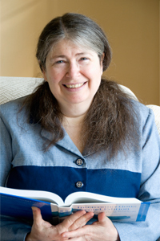
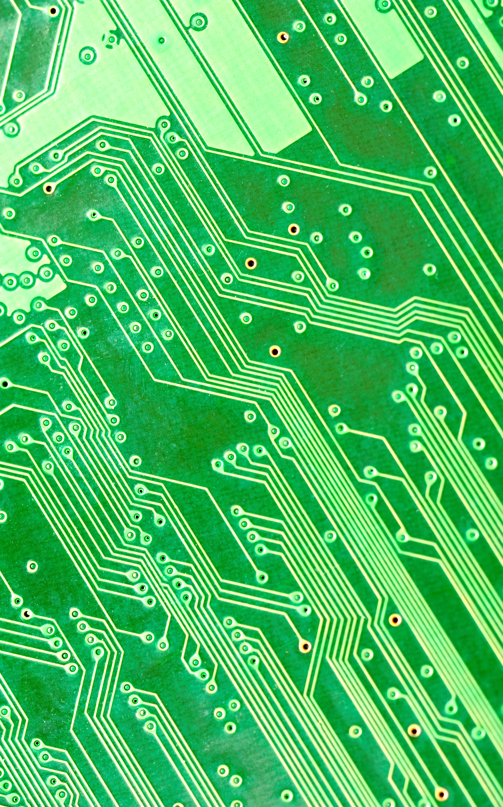
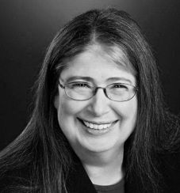
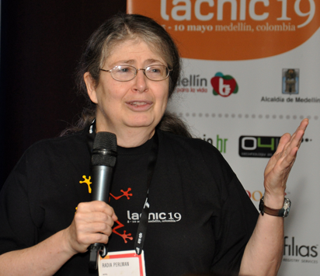
Women
Radia Perlman
“Mother of the Internet”
To change pictures:
Save the picture of the person you wish to use.
Single-left-click the grouped picture/shapes you wish to change on the poster. Single-left-click again on the picture.
Now single-right-click the picture and select “Change Picture” from the menu.
Choose the picture file you saved.
You may wish to single-left-click the grouped picture/shapes and single-left-click the new picture again to adjust its size or crop it—especially useful if the new picture is not the same aspect ratio as the previous one.
DO NOT CHANGE ROSIE THE RIVETER PICTURE!!!
In Technology
Grew up loving math and also enjoyed playing piano and the French horn
1973 Bachelor’s in Mathematics
1976 Master’s in Mathematics
1988 Ph.D. Computer Science
Holds more than 100 patents
She designed the spanning tree algorithm that transformed Ethernet from the original limited-scalability, single-wire CSMA/CD, into a protocol that can handle large clouds. Later, she improved on spanning tree-based Ethernet by designing TRILL (TRansparent Interconnection of Lots of Links), which allows Ethernet to make optimal use of bandwidth.
To Perlman, mathematics offered the best way to cut through the mumbo jumbo of computer language. "Math is sort of pure logic; there's a beauty and simplicity to it."
What paths will you trailblaze that no one has traveled before?

